Slide 1
Generalized Linear Models Logistic Model
Assoc. Prof. Susan Balaba Tumwebaze
Dr. Thomas L. Odong
Dr. Hellen Namawejje

Slide 2
Overview on Logistic regression
-Understanding the basics
-Some statistical test
-Logistic regression
-Interpretation of results

Slide 3
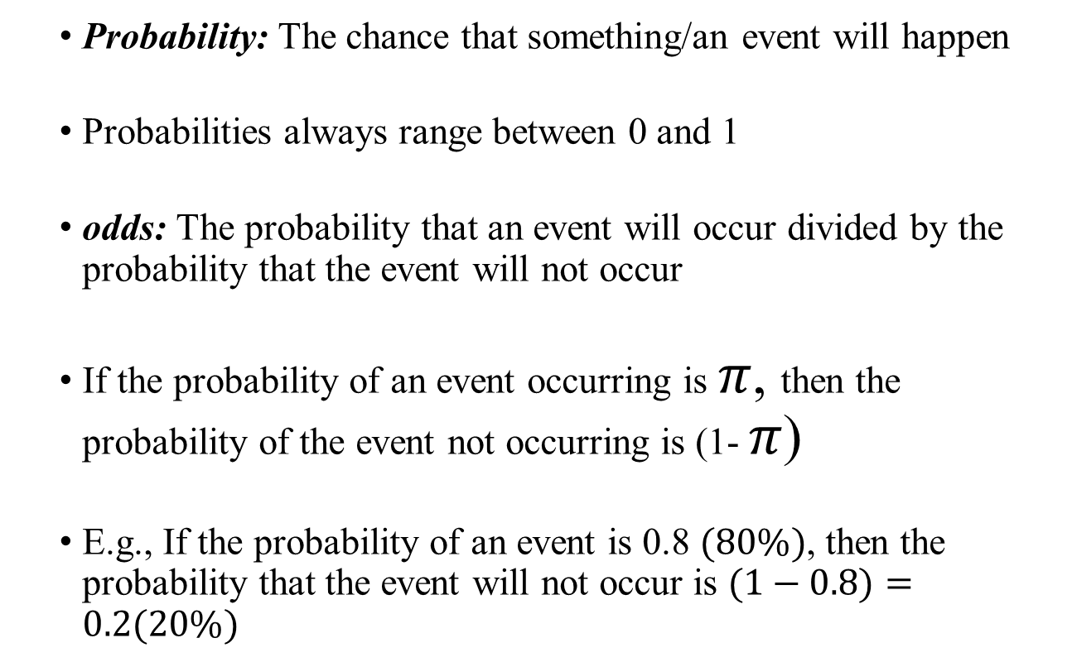
Understanding Basics
Probability: The chance that something/an event will happen
Probabilities always range between 0 and 1
odds: The probability that an event will occur divided by the probability that the event will not occur
If the probability of an event occurring is $π$, then the probability of the event not occurring is (1- $π$)
E.g., If the probability of an event is 0.8 $(80\%)$, then the probability that the event will not occur is $(1−0.8)=0.2(20\%)$

Slide 4
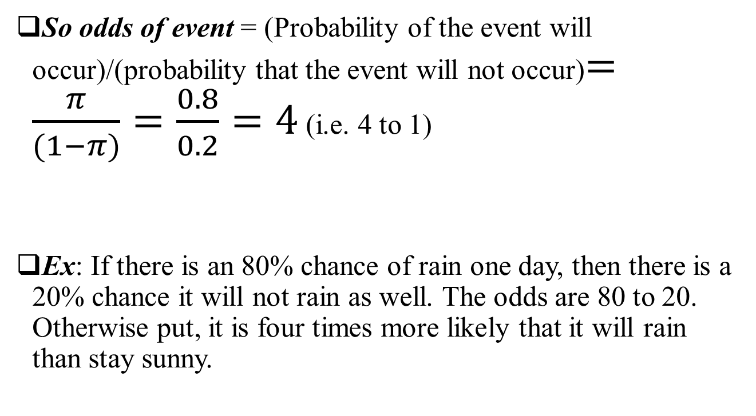
Understanding Basics continued
So odds of event = (Probability of the event will occur)/(probability that the event will not occur)$=\frac{π}{(1−π)}=\frac{0.8}{0.2}=4$ (i.e. 4 to 1)
Ex: If there is an 80% chance of rain one day, then there is a 20% chance it will not rain as well. The odds are 80 to 20. Otherwise put, it is four times more likely that it will rain than stay sunny.

Slide 5

Odds
Definition:
$$\frac{π}{1−π}$$
is the odds of Yes.

Slide 6
Understanding Basics continued
-The event that has the highest odds is considered the “favorite.” If the odds are low, it means that event is not likely to occur.
-The odds of price uptake is the probability that a diamond price is high to the probability that a diamond price is not high( low)

Slide 7
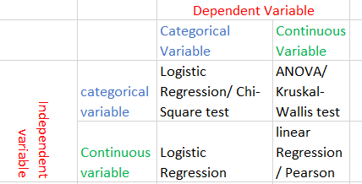
Some statistical test
Some of the statistical test that can be performed

Slide 8
Why use logistic regression?
There are many important research topics for which the dependent variable is "limited."
Binary logistic regression is a type of regression analysis where the dependent variable is a dummy variable: coded 0 (did not vote) or 1(did vote)

Slide 9
Categorical Response Variables
Examples:
Whether or not a person smokes
Binary Response
Success of a medical treatment

Slide 10
π = Proportion of “Success”
In ordinary regression the model predicts the mean Y for any combination of predictors.
What’s the “mean” of a 0/1 indicator variable?
Goal of logistic regression: Predict the “true” proportion of success,
π, at any value of the predictor.

Slide 11
Binary Logistic Regression Model
Y = Binary response
X = Quantitative predictor
π = proportion of 1’s (yes,success) at any X
Equivalent forms of the logistic regression model:
Logit form
Probability form
What does this look like?
N.B.: This is natural log (aka “ln”)

Slide 12
Binary Logistic Regression Model
Y = Binary response
X = Single predictor
π = proportion of 1’s (yes, success) at any x
Equivalent forms of the logistic regression model:
Logit form
Probability form

Slide 13
Binary Logistic Regression Model
Y = Binary response
X₁,X₂,…,X_{k} = Multiple predictors
X = Single predictor
π = proportion of 1’s (yes, success) at any x
π = proportion of 1’s at any x₁, x₂, …, x_{k}
Equivalent forms of the logistic regression model:
Logit form
Probability form

Slide 14
Logit Function

Slide 15
Odds
Logit form of the model:
The logistic model assumes a linear relationship between the predictors and log(odds).
⇒

Slide 16
Odds Ratio
A common way to compare two groups is to look at the ratio of their odds
Notes:
Sometimes a study fixes the number of cases and controls, e.g., 500 lung cancer patients and 500 persons without lung cancer. We can then estimate Pr{smoker|lung cancer} but we cannot estimate Pr{lung cancer|smoker} which is what a RR wants as input. But we can find the OR.

Slide 17
Odds Ratio
An odds ratio greater than 1 indicates that the condition or event is more likely to occur in the first group.
And an odds ratio less than 1 indicates that the condition or event is less likely to occur in the first group.

Slide 18
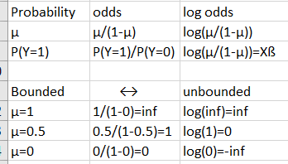
Logistic regression
Transforming from bounded to unbounded

Slide 19
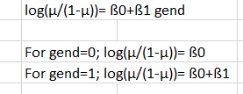
Simple Logistic regression

Slide 20
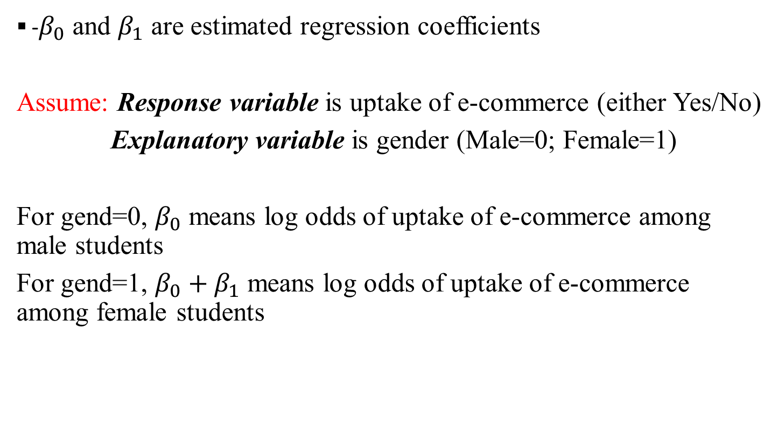
Simple Logistic regression Continued
-$β_{0}$ and $β_{1}$ are estimated regression coefficients
Assume: Response variable is uptake of e-commerce (either Yes/No)
Explanatory variable is gender (Male=0; Female=1)
For gend=0, $β_{0}$ means log odds of uptake of e-commerce among male students
For gend=1, $β_{0}+β_{1}$ means log odds of uptake of e-commerce among female students

Slide 21
Simple Logistic regression continued
Note:
From log odds , we can get odds ratio (OR) by taking an exponentiation of the value of the log odds

Slide 22
Example 1: Relationship between Treatment and Pain relief
Response variable: Pain free/Pain relief
Two groups: Yes/No
Explanatory variable: Using TMS or Placebo as treatment for migraines
Two groups: TMS / Placebo

Slide 23
Example: TMS for Migraines
Pain Free? | TMS | Placebo
YES | 39 | 22
NO | 61 | 78
Total | 100 | 100

Slide 24
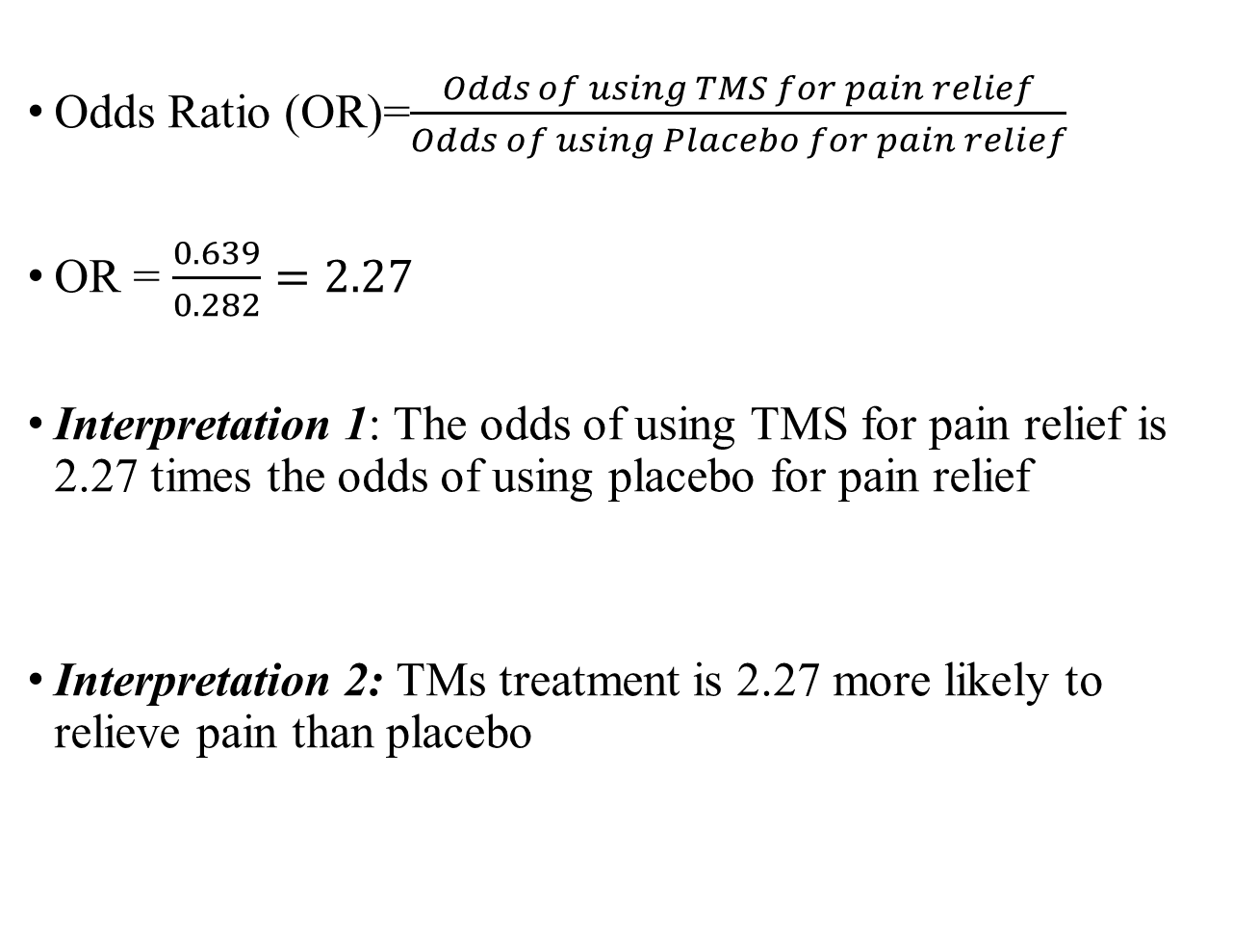
Odds Ratio (OR)=$\frac{Odds of using TMS for pain relief}{Odds of using Placebo for pain relief}$
OR = $\frac{0.639}{0.282}=2.27$
Interpretation 1: The odds of using TMS for pain relief is 2.27 times the odds of using placebo for pain relief
Interpretation 2: TMs treatment is 2.27 more likely to relieve pain than placebo

Slide 25
Logistic Regression for TMS data
> lmod=glm(cbind(Yes,No)~Group,family=binomial,data=TMS)
> summary(lmod)
Coefficients:
Estimate Std. Error z value Pr(>|z|)
(Intercept) -1.2657 0.2414 -5.243 1.58e-07 ***
GroupTMS 0.8184 0.3167 2.584 0.00977 **
---
Signif. codes: 0 ‘***’ 0.001 ‘**’ 0.01 ‘*’ 0.05 ‘.’ 0.1 ‘ ’ 1
(Dispersion parameter for binomial family taken to be 1)
Null deviance: 6.8854 on 1 degrees of freedom
Residual deviance: 0.0000 on 0 degrees of freedom
AIC: 13.701
Note: e^{0.8184} = 2.27 = odds ratio

Slide 26
PRACTICALS
Let us move to R and RStudio

